Slide 1
Crop Production Analysis In India

Slide 2
Introduction
The Agriculture business domain, as a vital part of the overall supply chain, is
expected to highly evolve in the upcoming years via the developments, which are
taking place on the side of the Future Internet. This paper presents a novel
Business-to-Business collaboration platform from the agri-food sector perspective,
which aims to facilitate the collaboration of numerous stakeholders belonging to
associated business domains, in an effective and flexible manner.

Slide 3
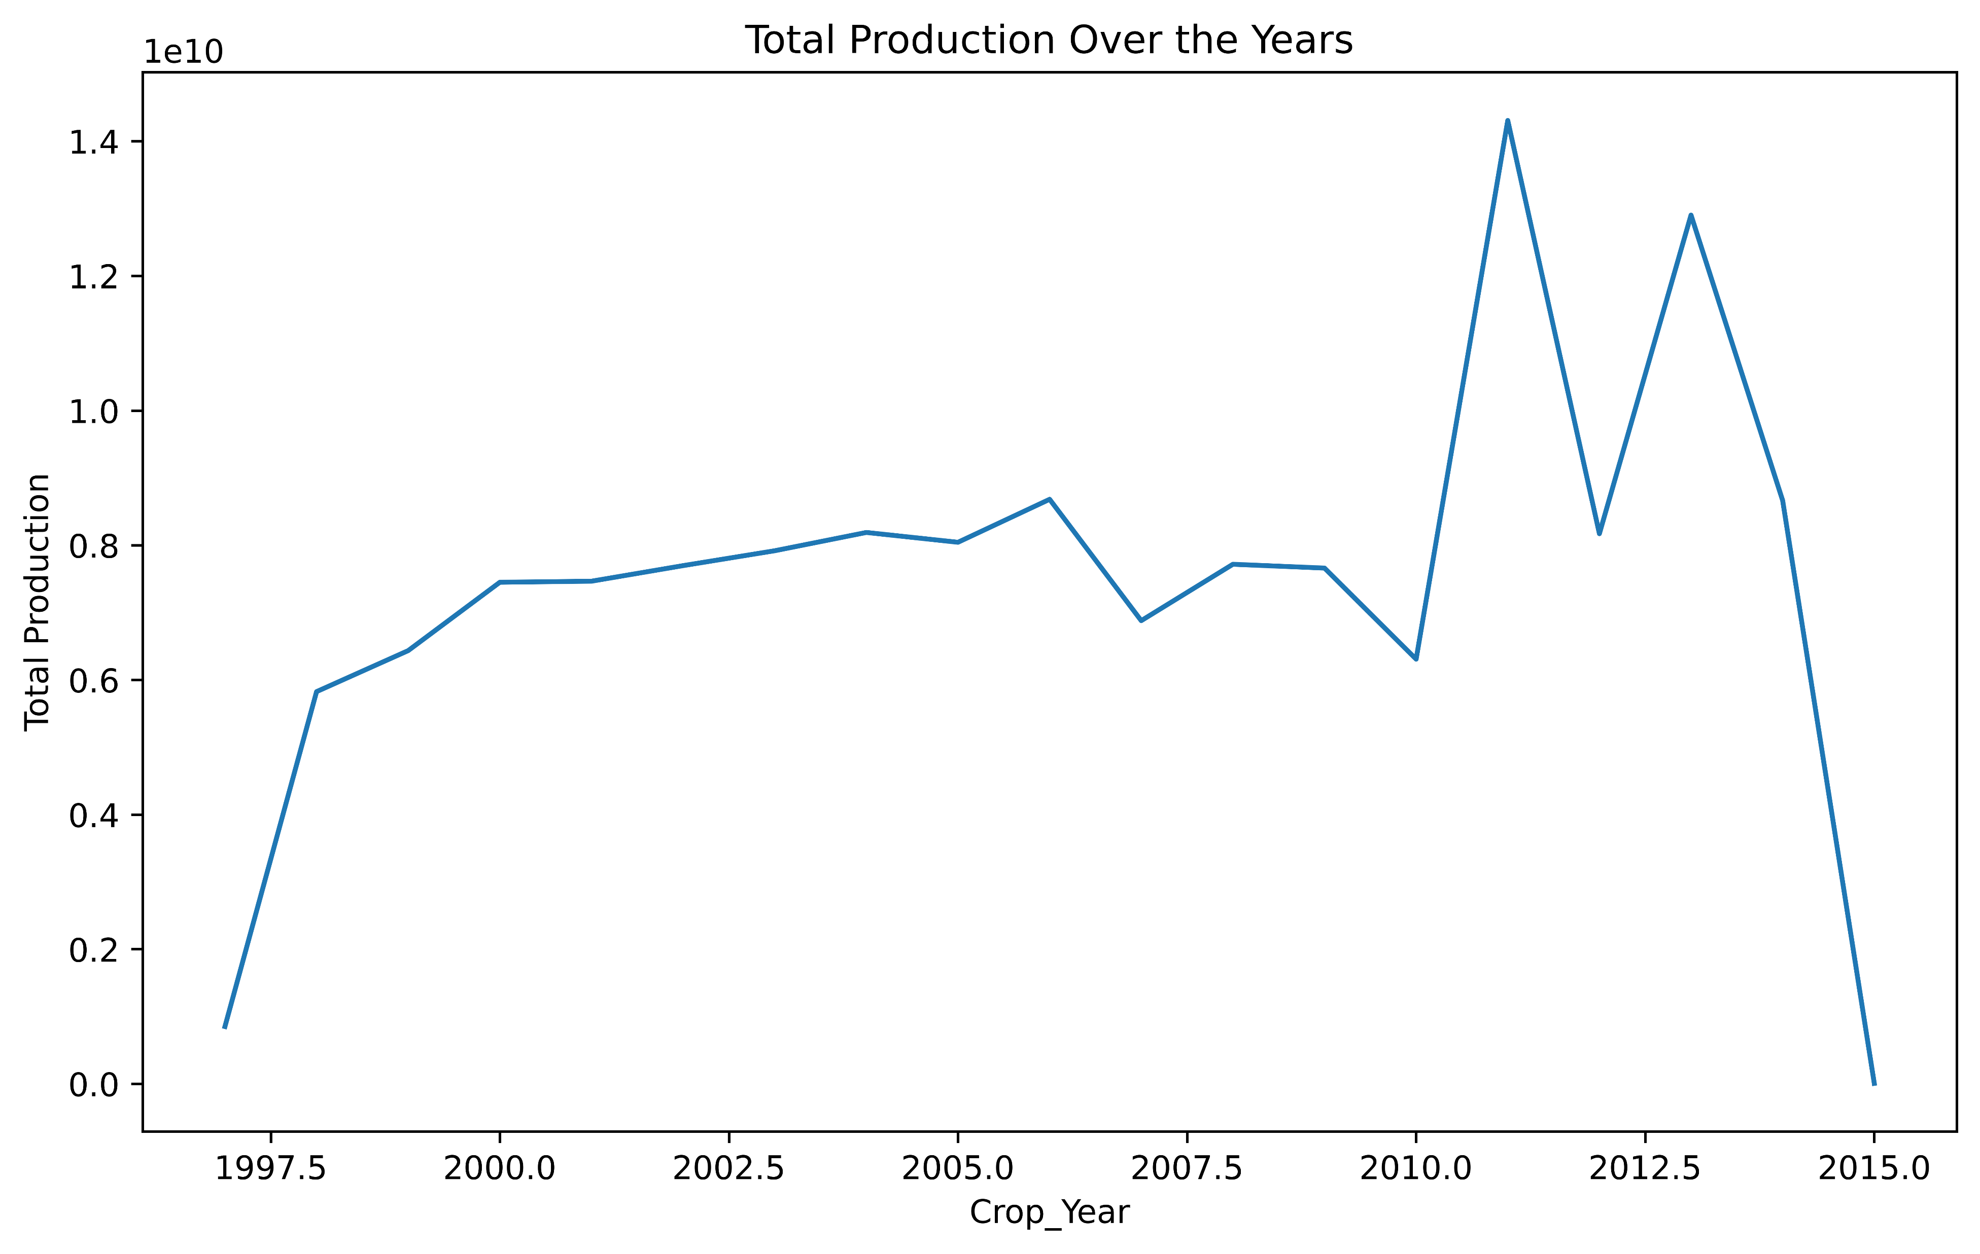
Total Production over the Year

Slide 4
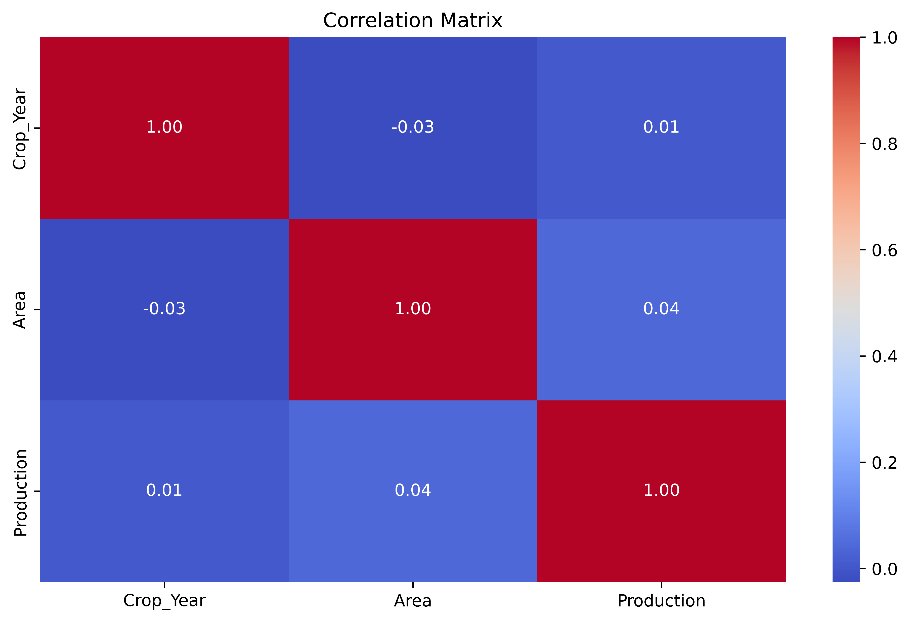
Correlation Matrix

Slide 5
Top 5 Crops with the highest productions
Coconut : 129,981,629,216.29
Sugarcane: 5,535,681,525.92
Rice: 1,605,470,383.37
Wheat: 1,332,825,656.80
Potato: 424,826,343.86

Slide 6
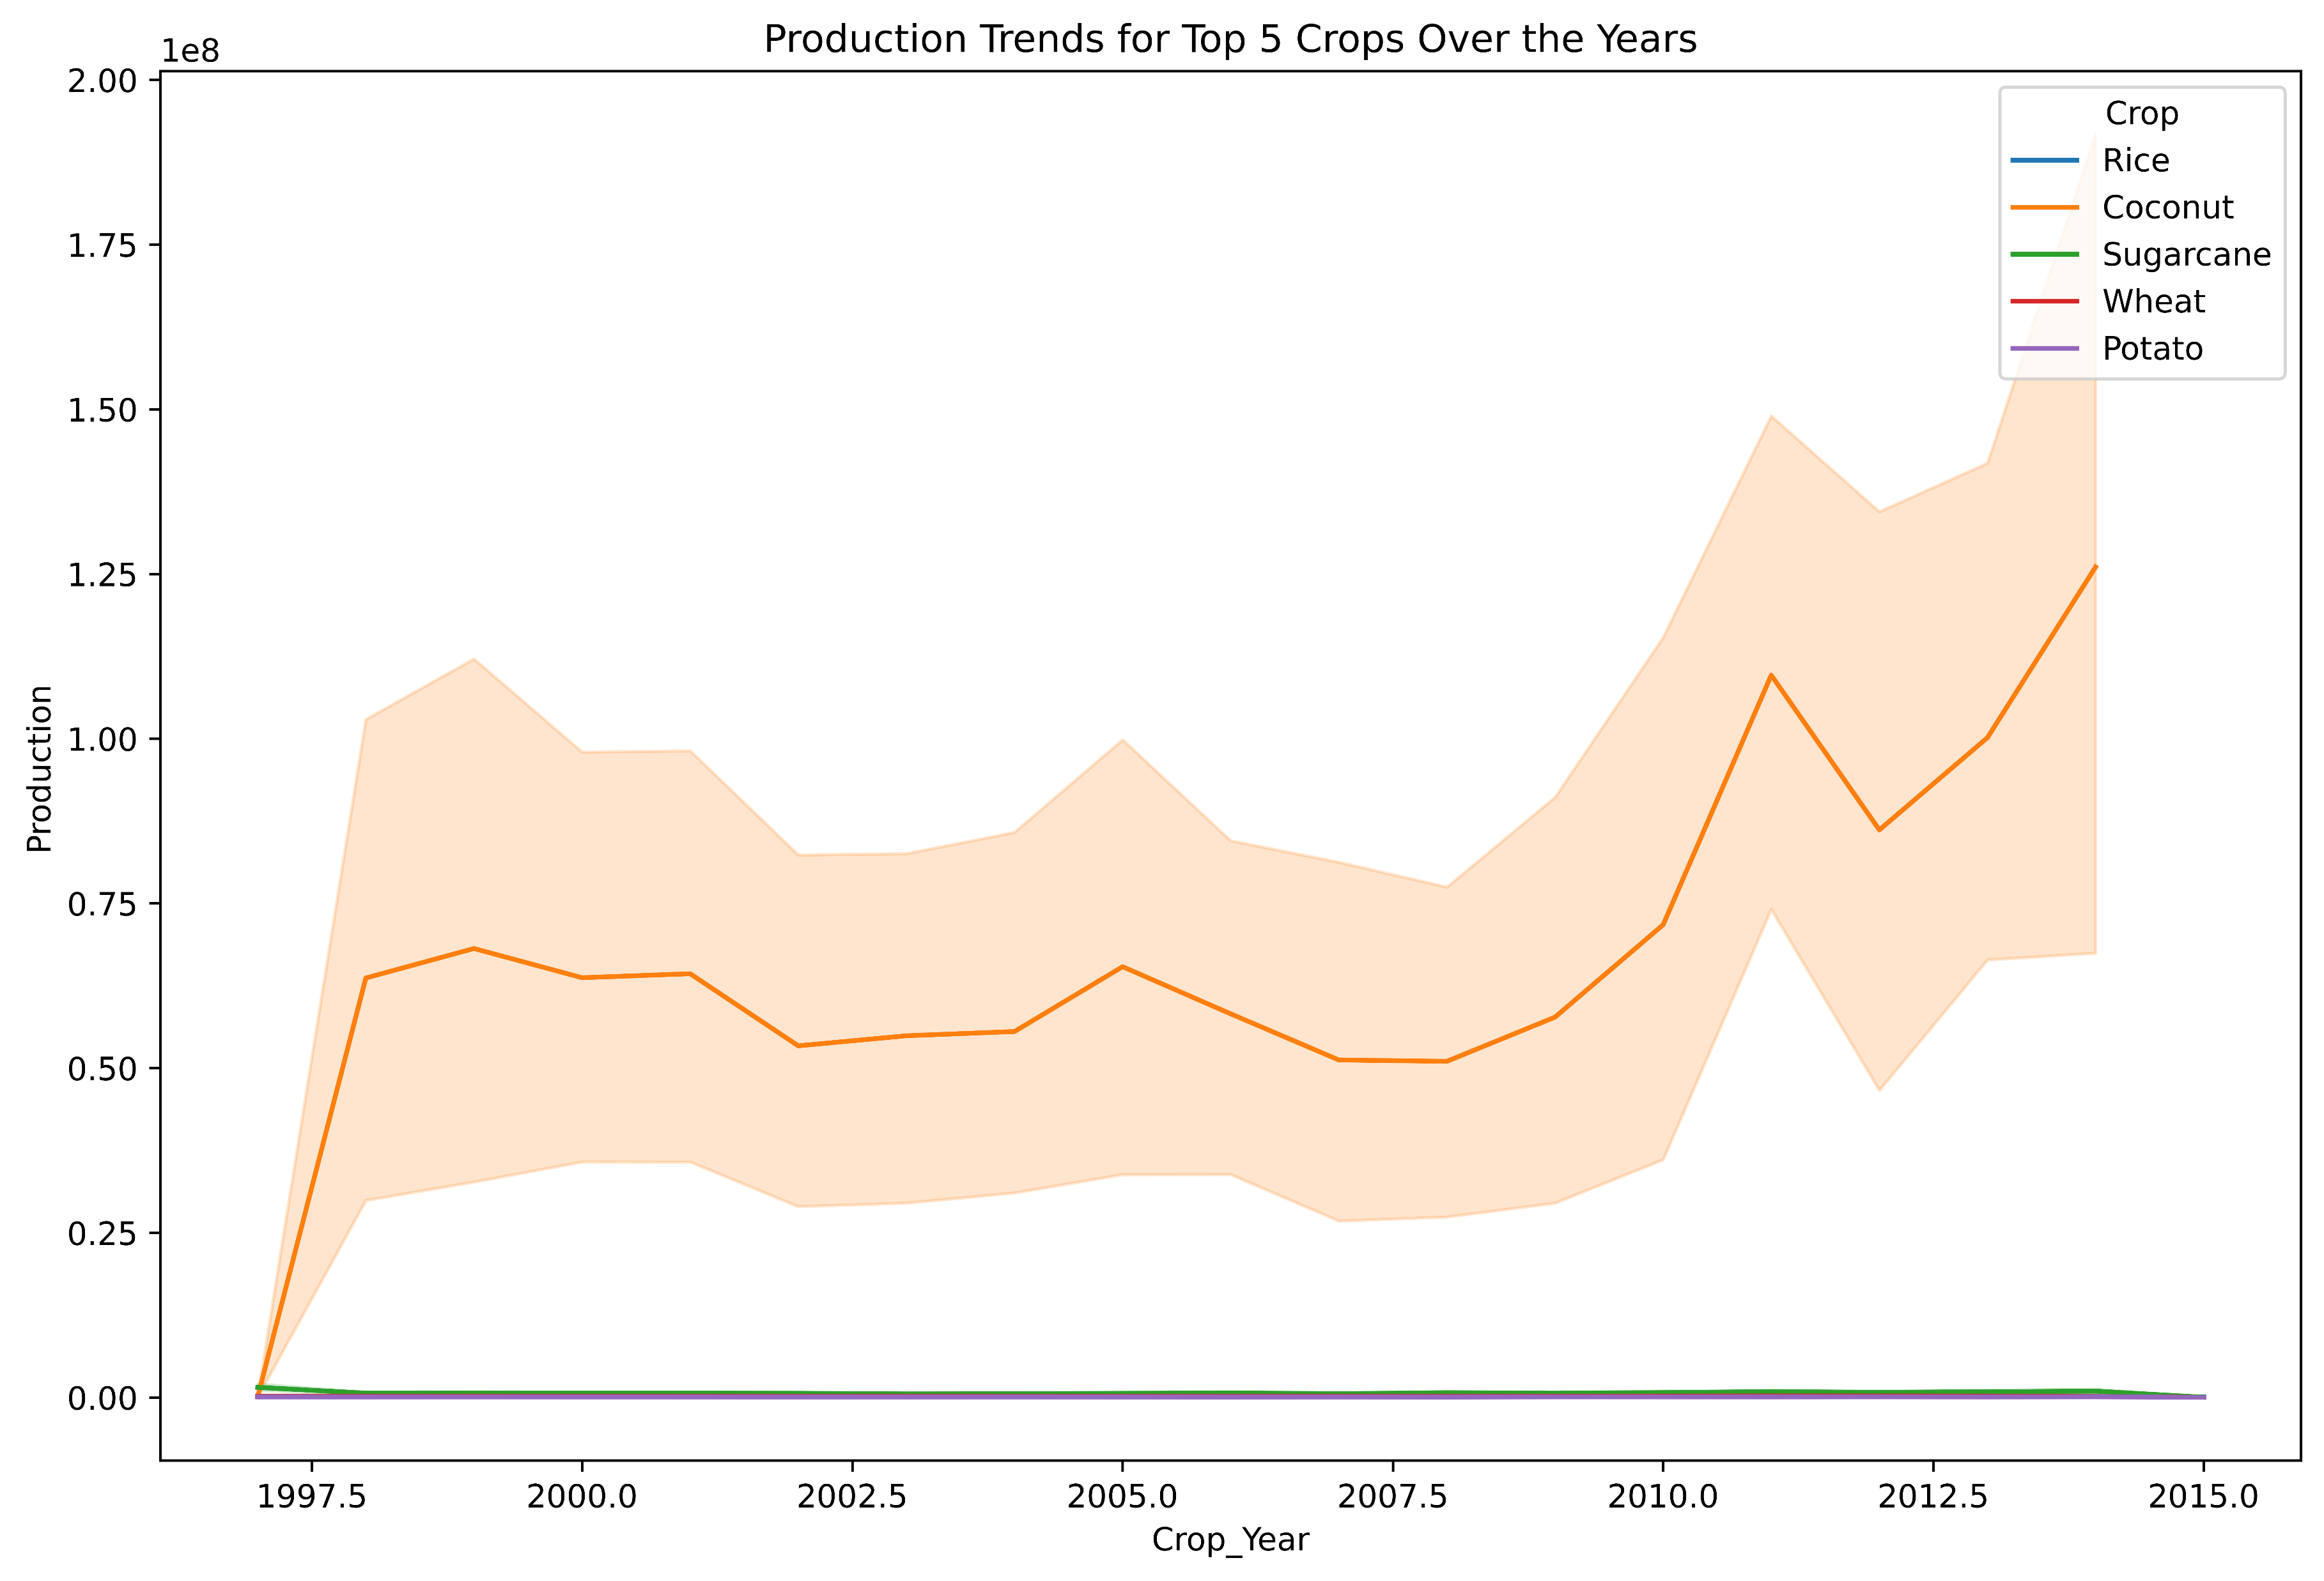
Production trends for the top 5 crops over the years

Slide 7
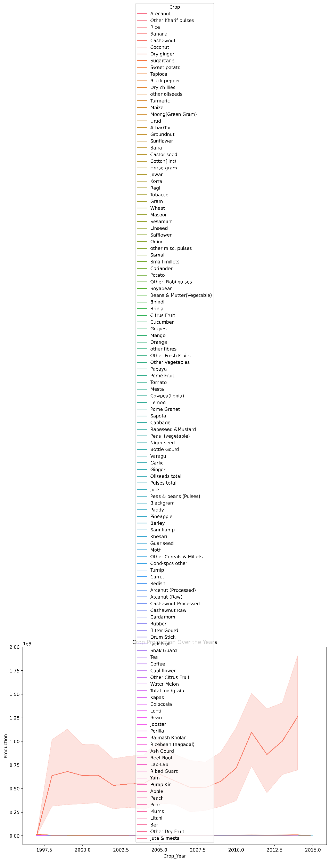
Time series analysis of crop production over the years

Slide 8
Thank You

